Slide 1
冒險故事
Vtube Studio

Slide 2
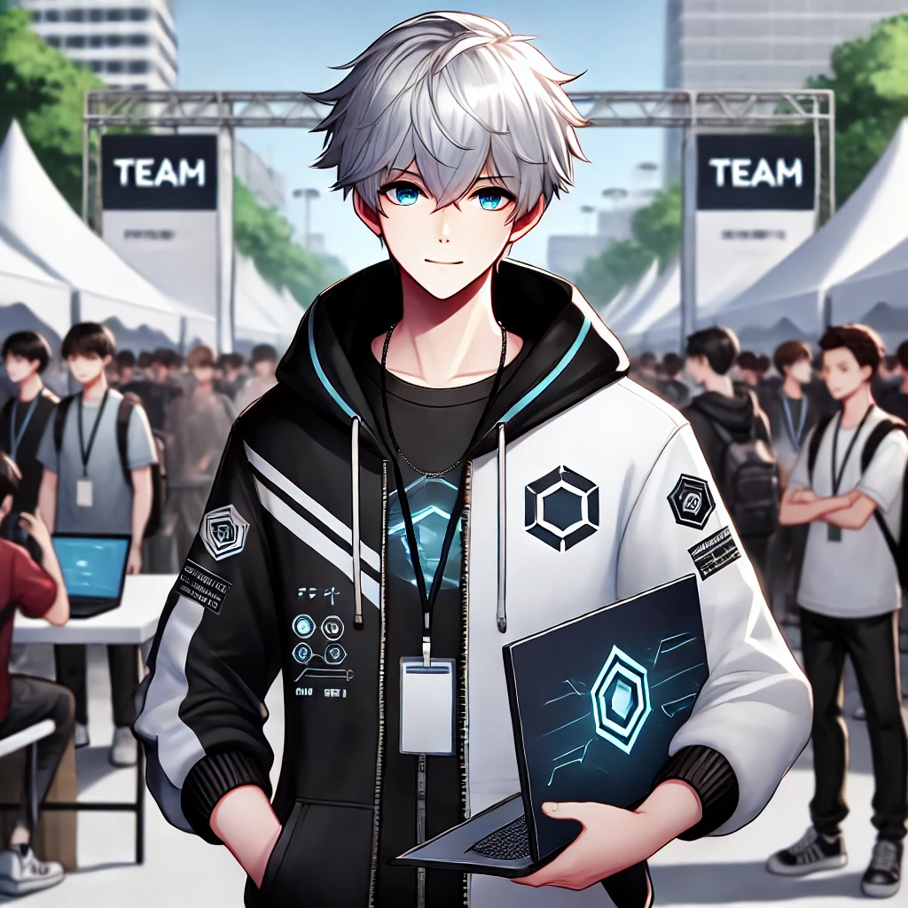
Notes:
A male character with silver-white hair, blue eyes, wearing a black and white hoodie with a futuristic design, standing confidently with a laptop in hand. He is at an outdoor tech event, with booths and other students in the background. The atmosphere is lively, and the character is excited, looking forward to the upcoming team competition.

Slide 3

Notes:
A male character with silver-white hair, blue eyes, wearing a black and white hoodie with a futuristic design, standing confidently with a laptop in hand. He is at an outdoor tech event, with booths and other students in the background. The atmosphere is lively, and the character is excited, looking forward to the upcoming team competition.
Create a detailed anime-style trophy, featuring intricate designs and bright colors. The trophy should be ornate, with decorative elements such as stars and ribbons. It should have a glossy finish that reflects light, emphasizing its shiny surface. The trophy stands prominently without any background, allowing the focus to be solely on its design.

Slide 4
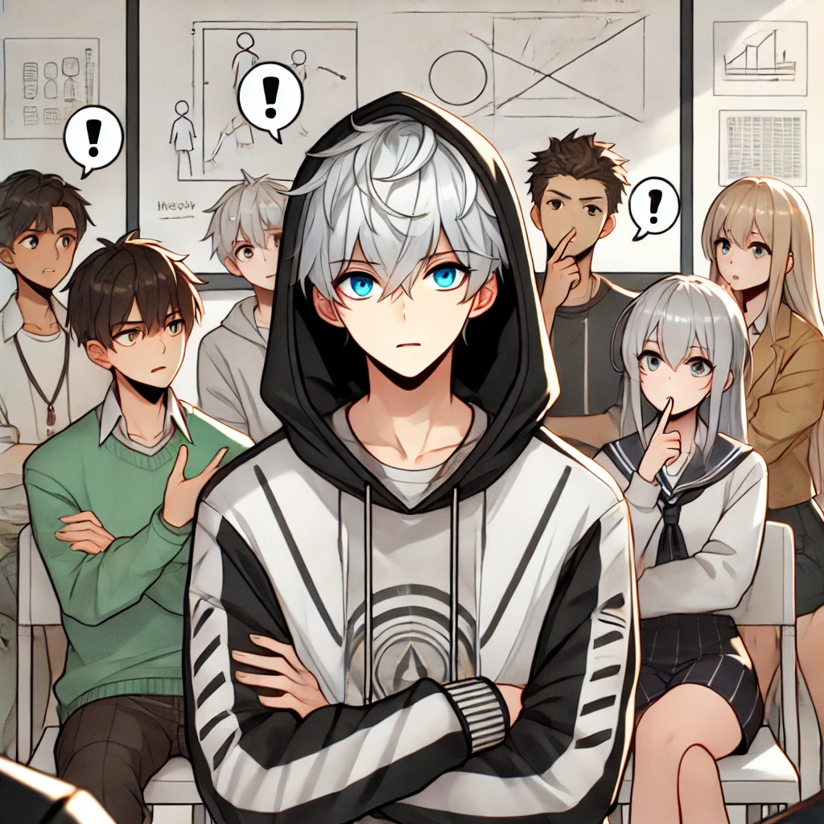
Notes:
The male character with silver-white hair, blue eyes, wearing a black and white hoodie with a futuristic design, sits in a room with a diverse group of students, each appearing frustrated or disagreeing during a discussion. The character has a slightly frustrated look as he tries to listen to multiple conflicting ideas, with a whiteboard behind them showing incomplete plans.

Slide 5
我覺得可以...
這裡應該…
這樣會比較好..
Notes:
The male character with silver-white hair, blue eyes, wearing a black and white hoodie with a futuristic design, sits in a room with a diverse group of students, each appearing frustrated or disagreeing during a discussion. The character has a slightly frustrated look as he tries to listen to multiple conflicting ideas, with a whiteboard behind them showing incomplete plans.

Slide 6

我覺得可以...
這裡應該…
這樣會比較好..
Notes:
The male character with silver-white hair, blue eyes, wearing a black and white hoodie with a futuristic design, sits in a room with a diverse group of students, each appearing frustrated or disagreeing during a discussion. The character has a slightly frustrated look as he tries to listen to multiple conflicting ideas, with a whiteboard behind them showing incomplete plans.

Slide 7
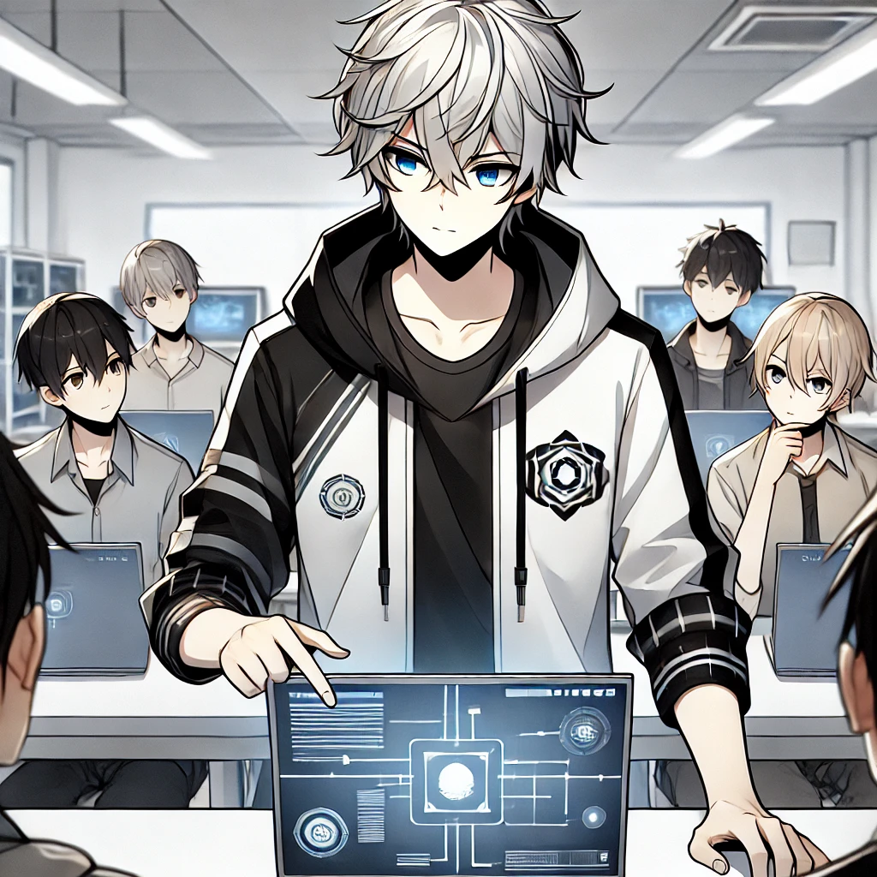
Notes:
The male character with silver-white hair, blue eyes, wearing a black and white hoodie with a futuristic design, standing up at a table surrounded by his teammates with different design, showing them a digital framework on his laptop. His face is focused and confident, while his teammates are starting to nod and engage with his ideas. The background shows the classroom filled with tech equipment, emphasizing the collaborative atmosphere.

Slide 8
Notes:
The male character with silver-white hair, blue eyes, wearing a black and white hoodie with a futuristic design, standing up at a table surrounded by his teammates with different design, showing them a digital framework on his laptop. His face is focused and confident, while his teammates are starting to nod and engage with his ideas. The background shows the classroom filled with tech equipment, emphasizing the collaborative atmosphere.

Slide 9
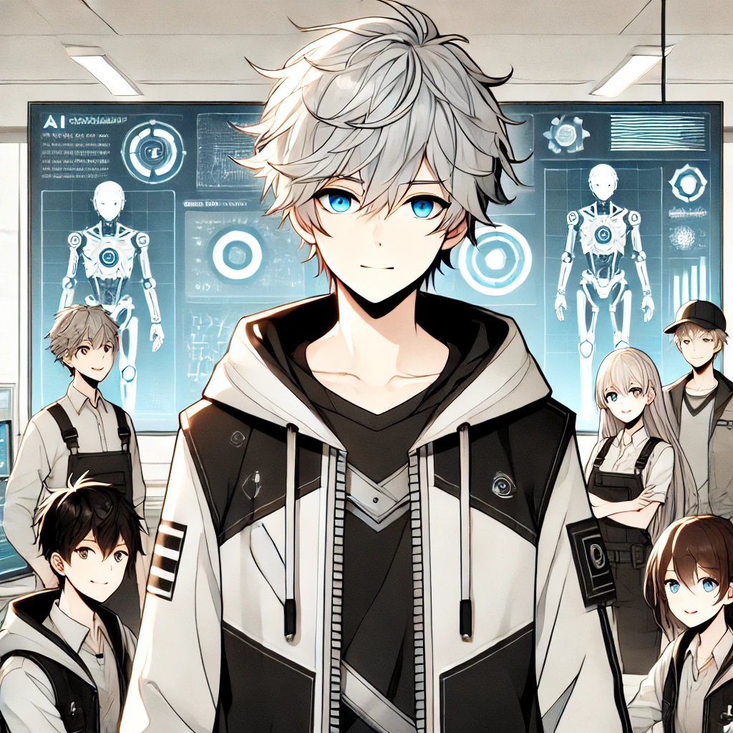
Notes:
The male character with silver-white hair, blue eyes, wearing a black and white hoodie with a futuristic design, stands with his team in front of a partially completed AI system on a large screen. The teammates are now smiling and working efficiently together, while the character looks relieved but still focused. The atmosphere is productive and positive, with the sense of progress in the air.

Slide 10
Notes:
The male character with silver-white hair, blue eyes, wearing a black and white hoodie with a futuristic design, stands with his team in front of a partially completed AI system on a large screen. The teammates are now smiling and working efficiently together, while the character looks relieved but still focused. The atmosphere is productive and positive, with the sense of progress in the air.

Slide 11
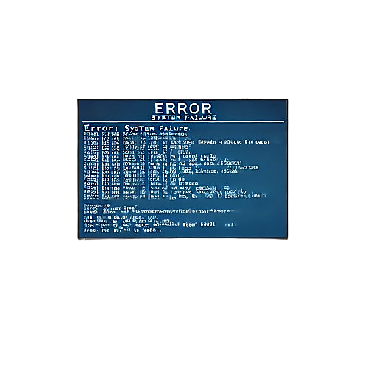
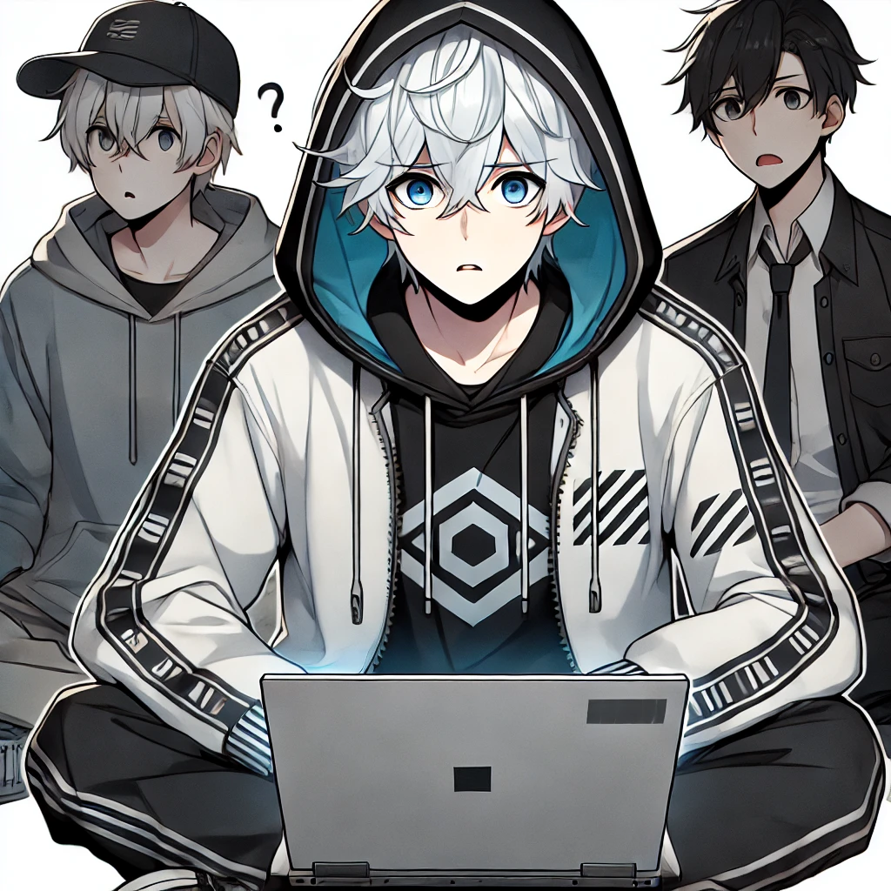
Notes:
The male character with silver-white hair, blue eyes, wearing a black and white hoodie with a futuristic design, sits with a concerned expression in front of his laptop. The screen shows an error or a slow-running AI model. His teammates around him are also worried, glancing at each other, while the character tries to think of a solution, indicating a technical issue causing stress.

Slide 12
Notes:
The male character with silver-white hair, blue eyes, wearing a black and white hoodie with a futuristic design, sits with a concerned expression in front of his laptop. The screen shows an error or a slow-running AI model. His teammates around him are also worried, glancing at each other, while the character tries to think of a solution, indicating a technical issue causing stress.

Slide 13
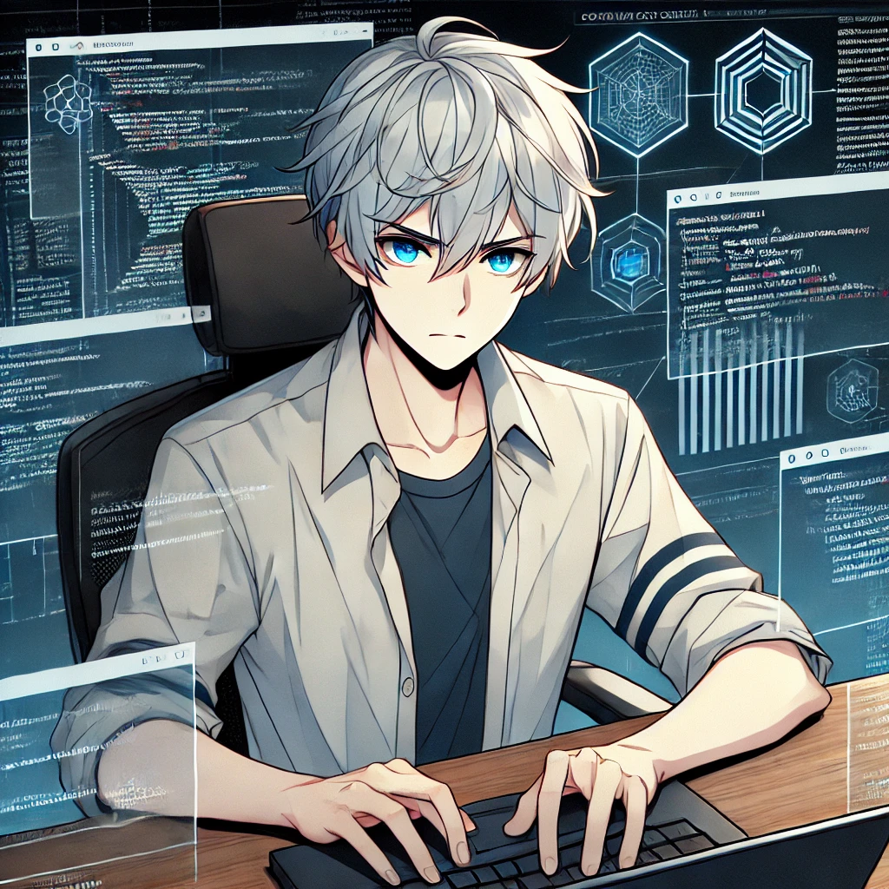
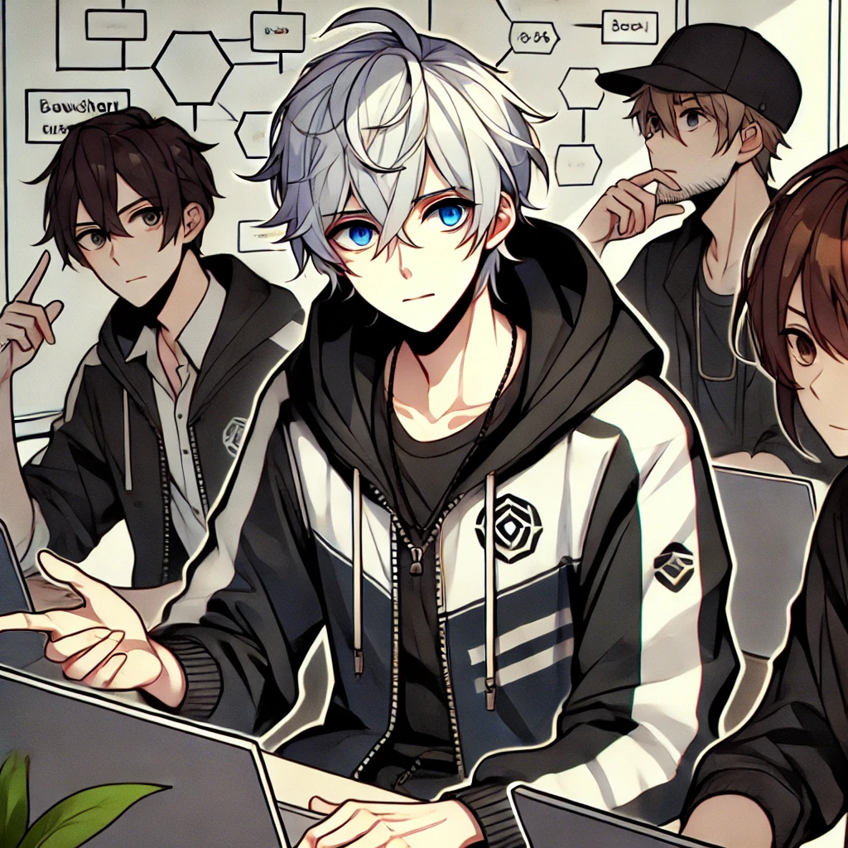
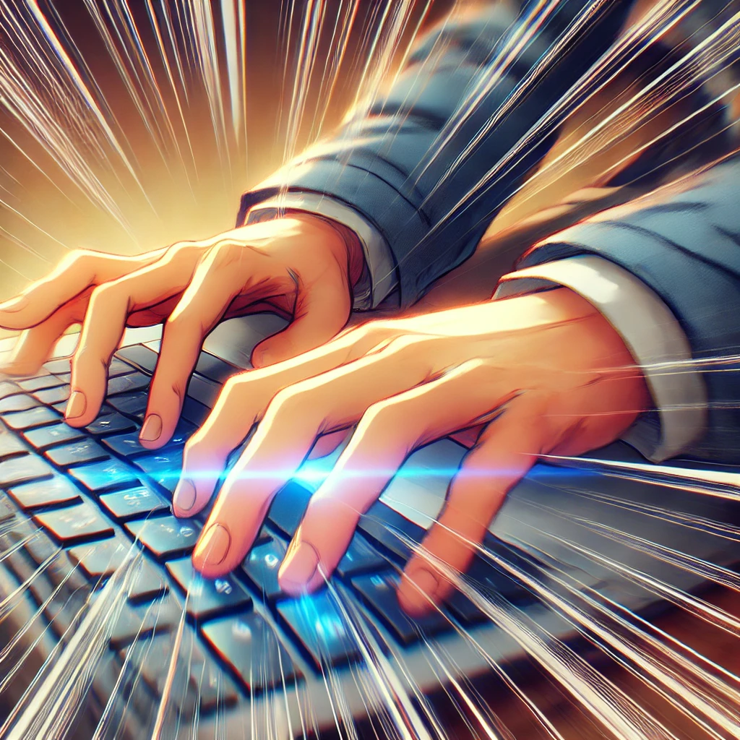
Notes:
The male character with silver-white hair, blue eyes, wearing a black and white hoodie with a futuristic design, every with a laptio, now gathered with his teammates in a brainstorming session, everyone engaged and actively discussing the problem. The character looks determined, pointing to a flowchart or some code on the whiteboard. The mood is serious but hopeful as the team works together on the solution.

Slide 14
Notes:
The male character with silver-white hair, blue eyes, wearing a black and white hoodie with a futuristic design, every with a laptio, now gathered with his teammates in a brainstorming session, everyone engaged and actively discussing the problem. The character looks determined, pointing to a flowchart or some code on the whiteboard. The mood is serious but hopeful as the team works together on the solution.
Create a close-up image of a character's hand energetically typing on a laptop keyboard. The hand should show dynamic movement, emphasizing speed and intensity. The background should be slightly blurred to highlight the action of typing. The hand should be illustrated in a vibrant anime style, with detailed features and a youthful appearance, capturing the determination and focus of the character.

Slide 15
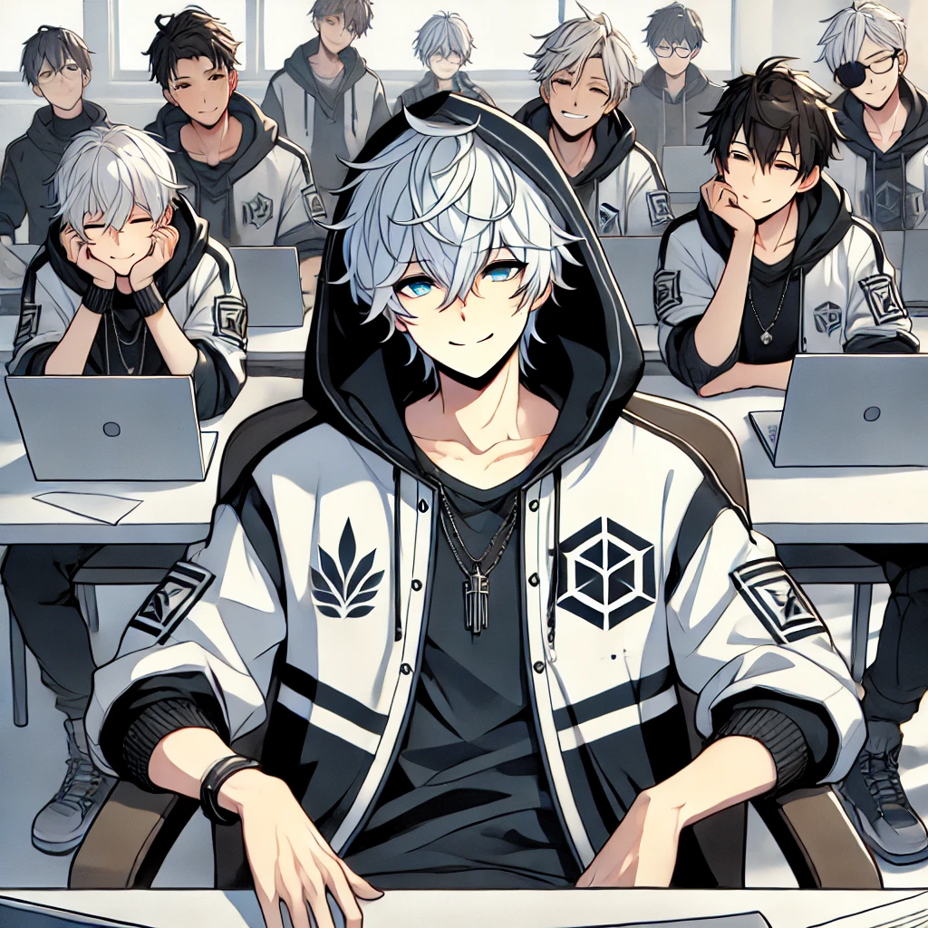
Notes:
The male character with silver-white hair, blue eyes, wearing a black and white hoodie with a futuristic design, sits back in a chair with a relieved expression, surrounded by his teammates. Everyone is sitting, smiling, or leaning back in their chairs, looking tired but satisfied. Laptops and papers are scattered on the table in front of them, indicating their hard work is finally done. The atmosphere is calm and relaxed, with the background showing a quiet classroom or project workspace.

Slide 16
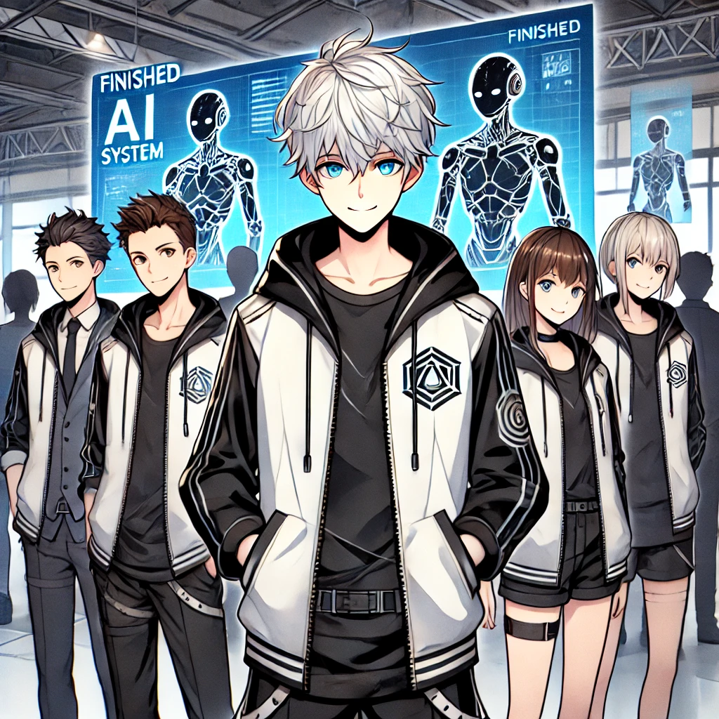
Notes:
The male character with silver-white hair, blue eyes, wearing a black and white hoodie with a futuristic design, stands smiling with his teammates next to their finished AI system, which is displayed on a large screen. The atmosphere is celebratory but calm, with everyone looking proud of their work. The background shows the event hall with other participants and judges, signifying the conclusion of the competition.

